Slide 1



OpenHW Website
Project Related Pages
Duncan Bees duncan@openhwgroup.org
© OpenHW Group
May 2020

Slide 2
Purpose of Presentation
Presented September 5, 2020
Presented by Duncan Bees, OpenHW Group
Purpose: to discuss plan for updating project related web pages with OpenHW TWG
See last page for addendum added after TWG meeting to summarise the decisions made

Slide 3
Proposed update to OpenHW web site to better explain projects
Better align information presented on openhwgroup.org to the way we are organized
The different elements to work with
  Eclipse Top Level Project == “OpenHW” (an organizational notion to Eclipse)
  Eclipse Project
    An Eclipse project for OpenHW is a technical area and group of committers. So there may be multiple OpenHW Technical projects within each Eclipse project. Currently only one.
    Each Eclipse Project has a Committer group
    Currently, the single Eclipse project is CORE-V Cores
    In future, we should likely add CORE-V SW as an Eclipse Project
  OpenHW WG == TWG + Cores TG + SW TG + Verification TG + ….
  OpenHW Technical Project ==
    CV32E40P
    CVA6
    Cores SW Tools (one or more actual projects)
    FPGA (actual name?)
    Dev board (actual name?)
    More in future
  OpenHW repository organized essentially by WG (TG) area

Slide 4
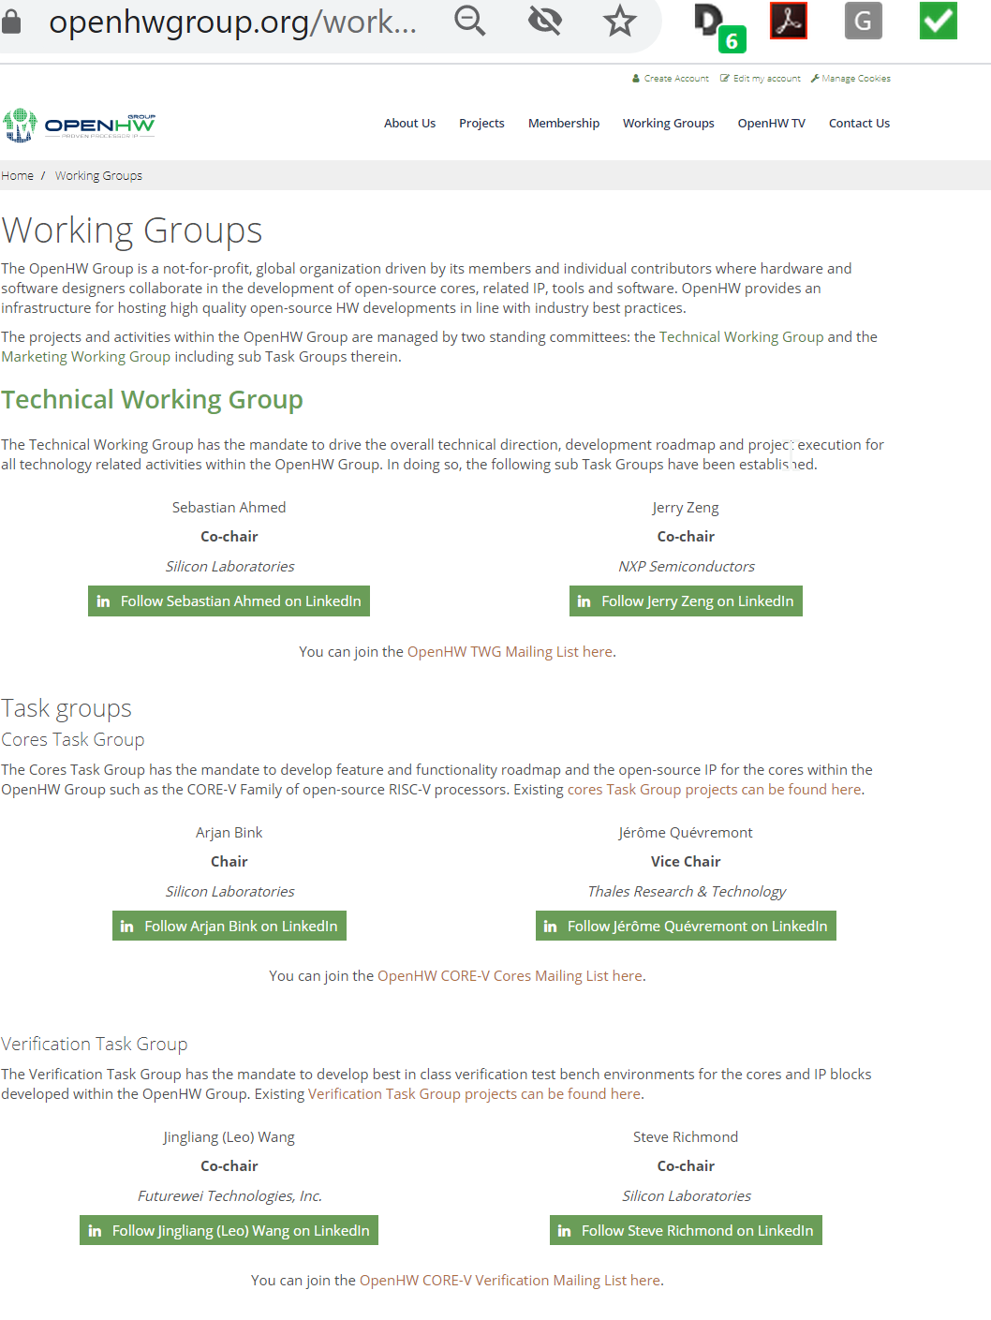
Current Working Groups page
This page accurately reflects our WG structure and should basically be left alone
JB suggestion: add link to repositories on this page

Slide 5
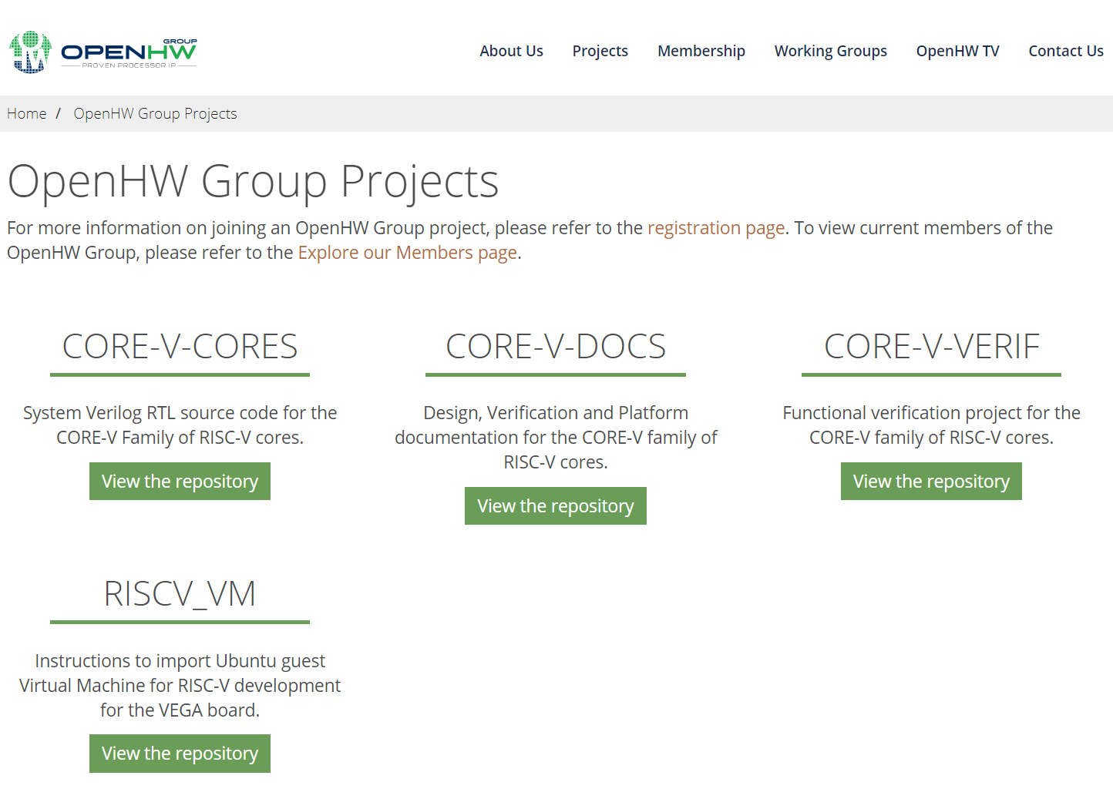
Current OpenHW Projects page
This page does not reflect our project structure.
What is listed is basically the repository structure, not OpenHW Technical projects.
That’s fine but it needs a different title etc.

Slide 6


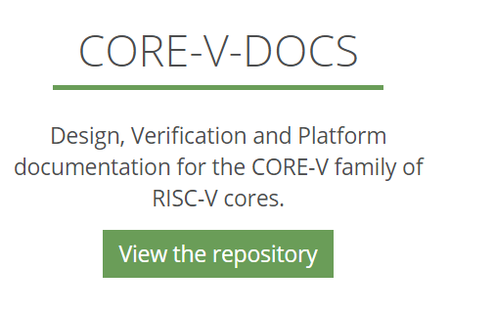
Proposed Edit
Repositories
Repositories
Descriptive text to be agreed for each repo
Re-title the current page to focus on Repositories rather than projects
Describe the repositories. Potential description
  active or potential OpenHW technical projects
  OpenHW WG involved
  Link to the appropriate Eclipse project page
OpenHW Technical Projects
CVE3240P
CVA6
Eclipse Project Page
https://projects.eclipse.org/projects/openhw.corev
SW

Slide 7

New Technical Projects Page
When we have enough well-described OpenHW technical projects, add an OpenHW Technical Projects page that lists the active projects and their status
Probably include a link to the specific subrepositories for each OTP (if appropriate)
JB: group projects in hierarchy and link to more information
Technical Projects
Technical Projects
Project Description Status
CV32E40P a 32 bit processor that… Launched
CVA6 a 64 bit processor that… Scoping
CORES-V Tools a set of tools that do … Scoping

Slide 8
Relationship between OTP and Eclipse Project (for the project management document, not the web site)
Eclipse Top Level Project:
OpenHW Group
Eclipse Project:
CORE-V Cores
Committer Group - Cores
Eclipse future Project:
CORE-V Software
Committer Group - SW
Other future Eclipse project
OHW Technical Project #1
OHW Technical Project #2
OHW Technical Project #3
OHW
Technical Project #4
OHW SW Technical Project #5
Other OHW project
OpenHW Technical Projects developing CORE-V Cores.
OpenHW Technical Projects developing SW tools.

Slide 9
Addendum added after TWG meeting
TWG decided to simplify the proposal as follows
  collapse the working group, project, and repository pages into a simple single webpage that links to the Github repositories
  An overall summary of projects will be provided by linking to a .md based dashboard
  This will avoid need to maintain the webpages themselves as projects evolve.

